Slide 1
SUBMITTED BY:
AJAY MAHARJAN (HCE075BCT006)
ASHISH RAI (HCE075BCT042)
NIBENDRA BAJRACHARYA (HCE075BCT015)
SUJAN MAHARJAN (HCE075BCT037)
A FINAL YEAR MAJOR PROJECT
ON
IMAGE INPAINTING USING GENERATIVE ADVERSARIAL NETWORKS (GAN)
[CT 707]
SUBMITTED TO:
DEPARTMENT OF ELECTRONICS AND COMPUTER ENGINEERING

Slide 2
Introduction
Image Inpainting underlie Image Processing using deep learning technique.
Improve the quality of an images
Recover the lost fragment or remove the object completely.

Slide 3
Problem Statement
Difficult to restore or recover corrupt image.
Requires photoshop skills which is a tedious process.

Slide 4
Objective
To reconstruct damaged parts or missing parts of image using GANs.

Slide 5
Scope and Applications
To reconstitute the missing or damaged portions of the work.
To edit an image i.e. object removal.

Slide 6
Requirement Analysis
Functional Requirements:
Register
Login
Upload images
Image inpainting
Download image

Slide 7
Non-Functional Requirements:
Reliable
Availability
Performance
Scalability
Maintainability
Security

Slide 8
Feasibility Study
Technical Feasibility - Hardware and software tools are within accessible boundaries.
Operational Feasibility - Simple and interactive interface and data drive.
Economic Feasibility - Only a computer is required to access the web application

Slide 9
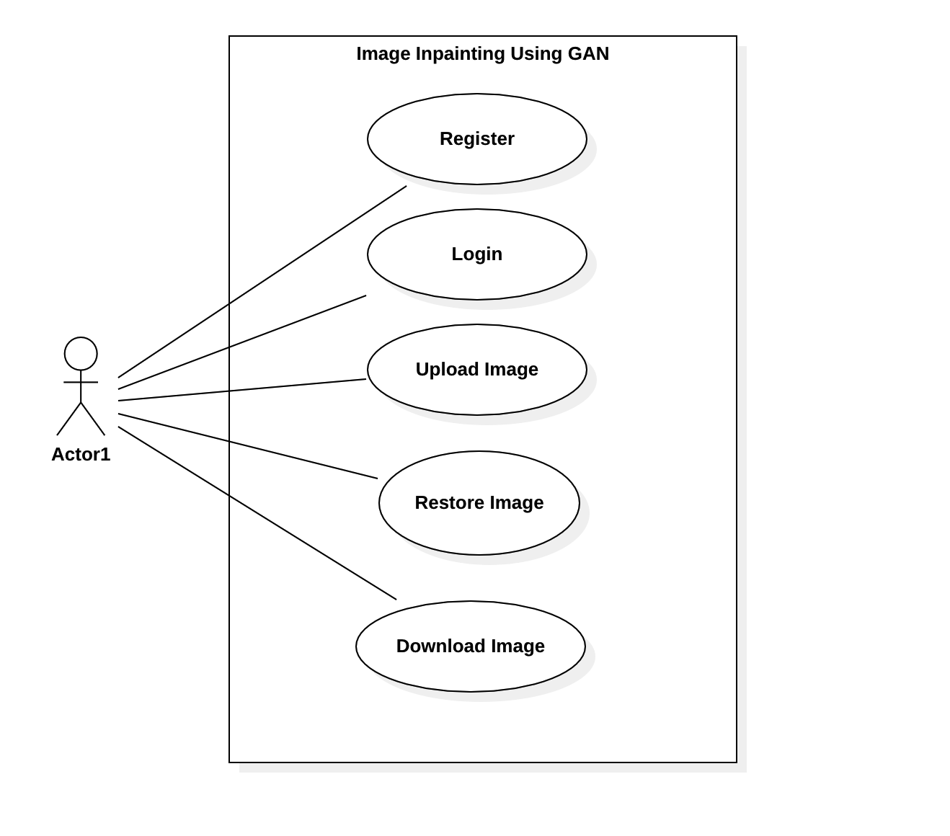
System Design
Use Case Diagram

Slide 10
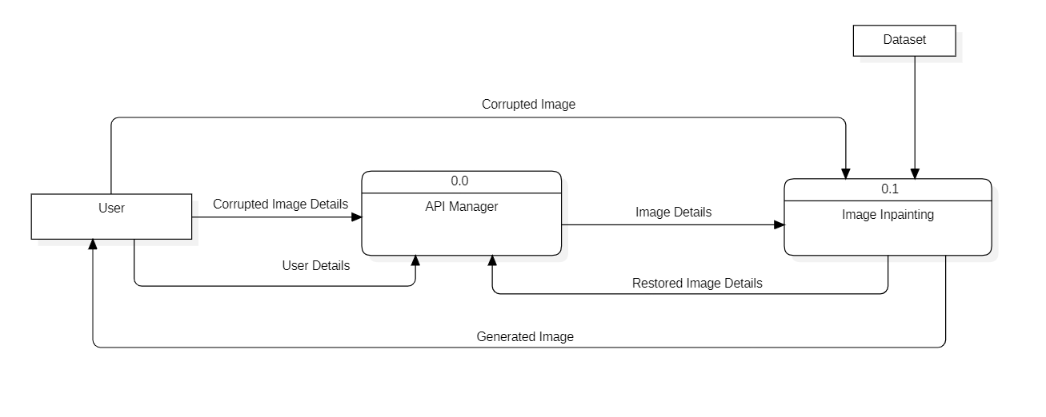
Data Flow Diagram Level 0

Slide 11
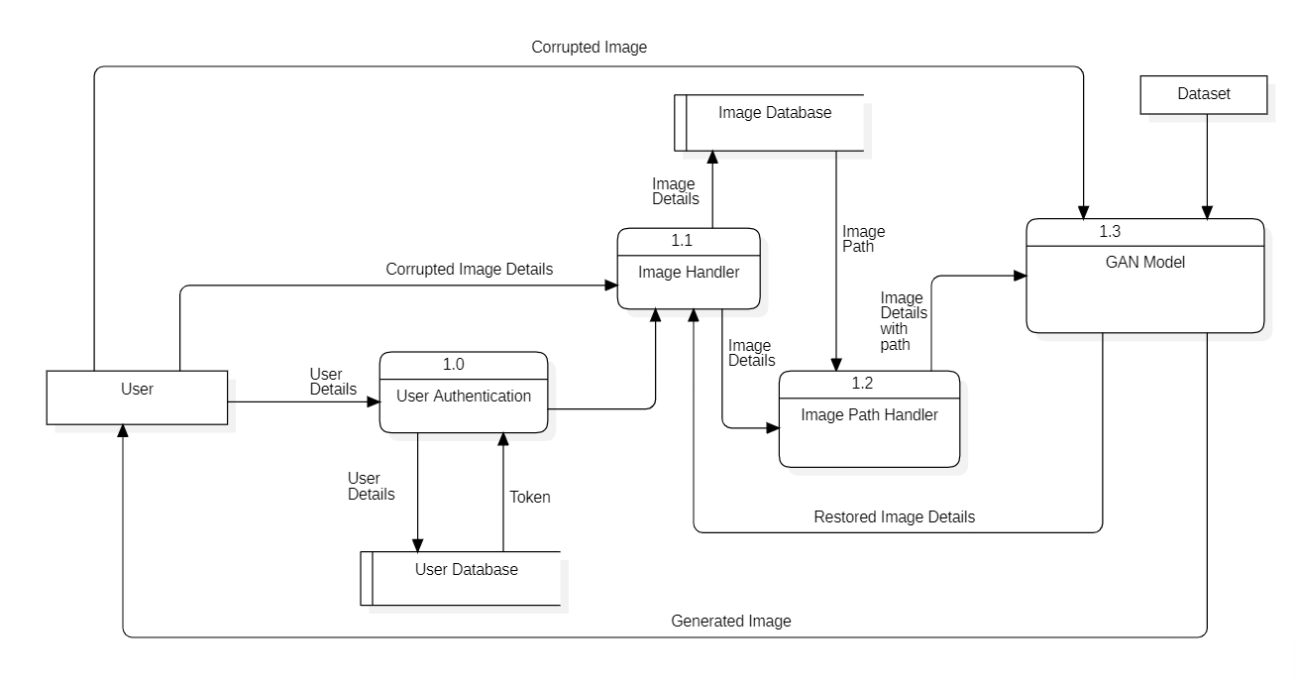
Data Flow Diagram Level 1

Slide 12
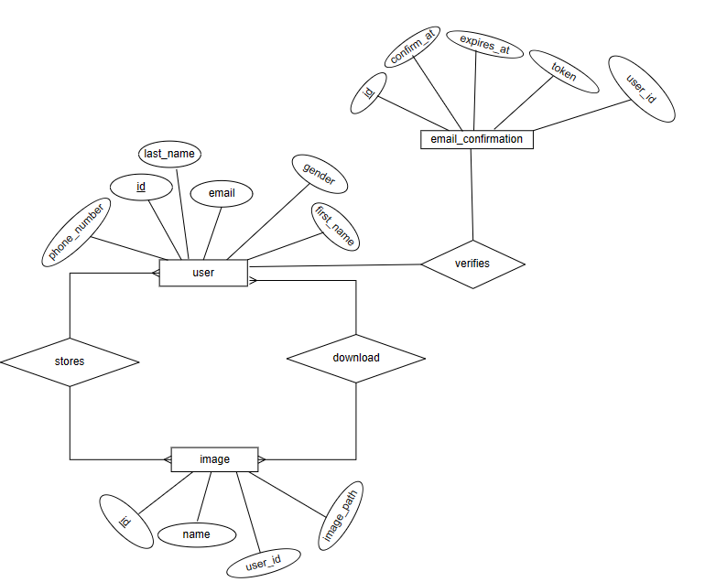
ER Diagram

Slide 13
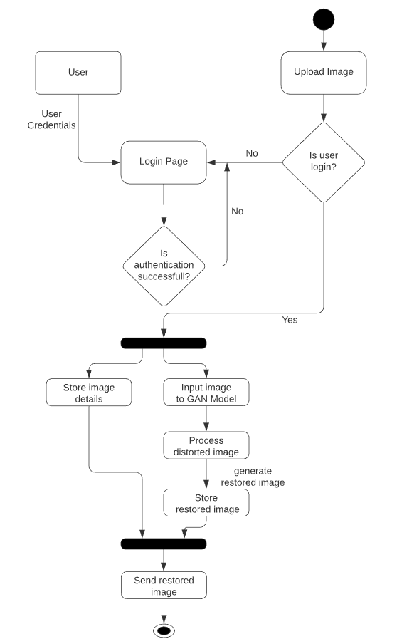
Activity Diagram

Slide 14
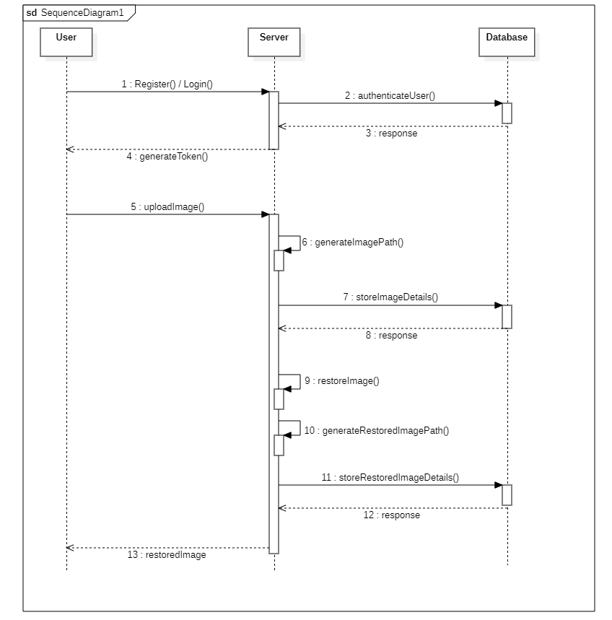
Sequence Diagram

Slide 15
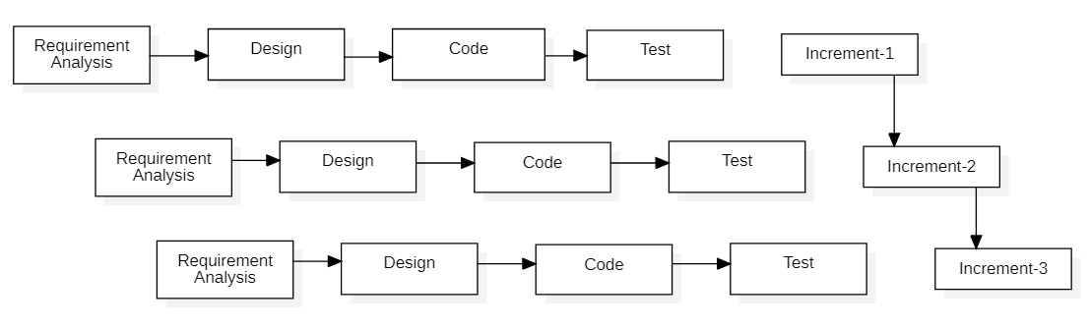
Methodology
Fig : Block diagram of incremental model

Slide 16
Conditional GAN
The main objective is to implement the Conditional GAN for image inpainting.
In GAN, two models are trained simultaneously:
Generator - Captures data distribution and generates images
Discriminator – Estimates the probability that a sample came from training data rather than the Generator.
Both generator and discriminator are conditioned on the same auxiliary information, such as class labels or input data.

Slide 17
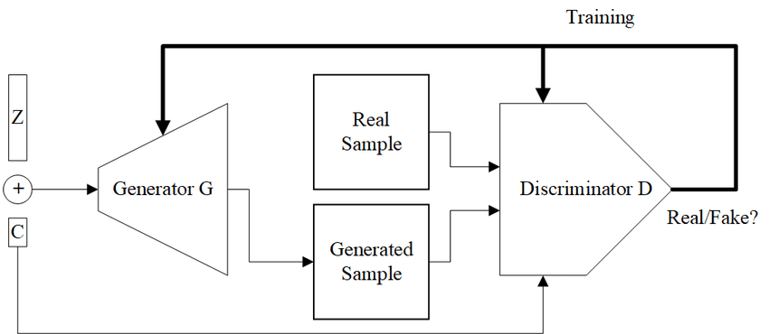

Slide 18
Pix2Pix model
a type of conditional GAN, where the generation of the output image is conditional on a source image
Generator is trained via adversarial loss, which encourages to generate plausible images
Discriminator must determine whether the target image is plausible transformation of the source image

Slide 19
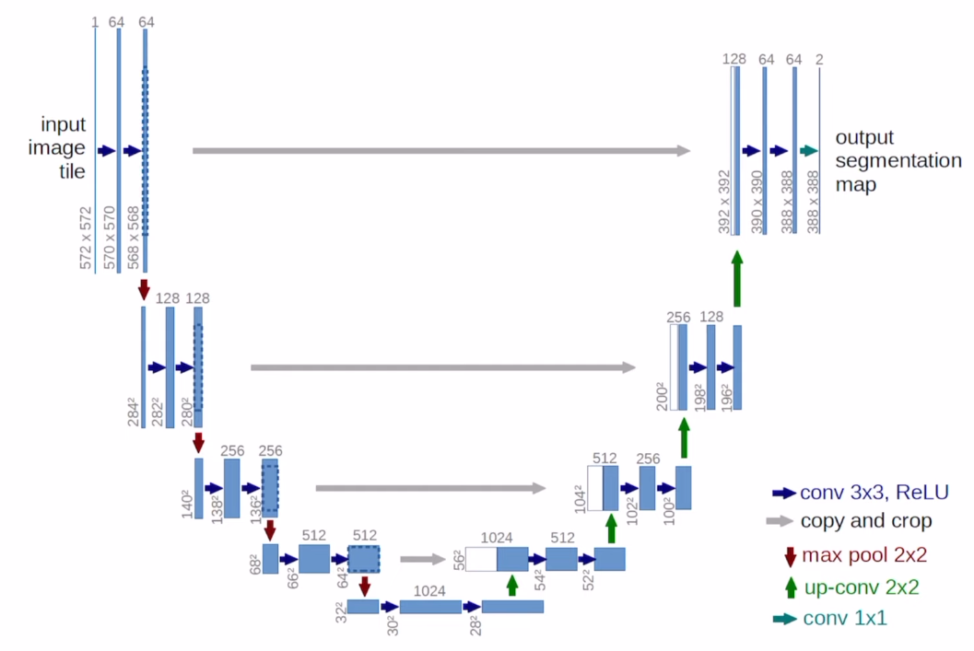
Generator

Slide 20
The network architecture of the generator is based on U-Net.
consists of the convolutional layers in encoder-decoder fashion, that generates the recovered images from cropped images.
The left side of the network is Contracting path or Encoder.
The right side of the network is Expansive path or Decoder.
The generated image of the generator is then injected into the discriminator, that determines whether the image is real or fake.

Slide 21
Each block in the encoder is: 2-D Convolution for down sampling -> Batch normalization -> Leaky ReLU
Each block in the decoder is: Transpose 2-D Convolution for up sampling -> Batch normalization -> Dropouts -> ReLU
Skip connections between the encoder and decoder, which will help to upsample the image back to the original resolution
With skip connections, it’s possible that the output of the network to be a function of both input image and some fine-grained deep features.

Slide 22
Generator loss
The generator loss is a sigmoid cross-entropy loss of the generated images and an array of ones.
Also includes L1 loss, which is MAE (mean absolute error) between the generated image and the target image.

Slide 23
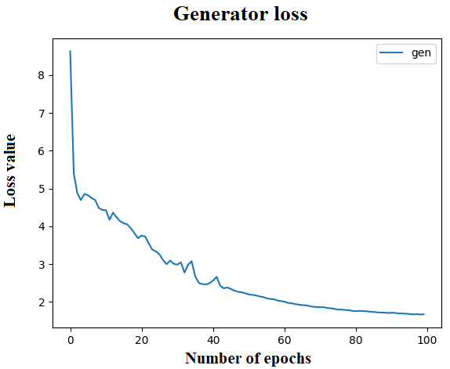
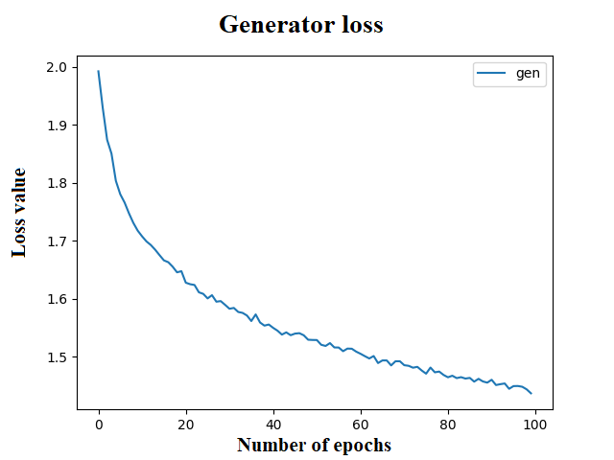
Fig: Generator Loss for first 5K images
Fig: Generator Loss for second 5K images

Slide 24
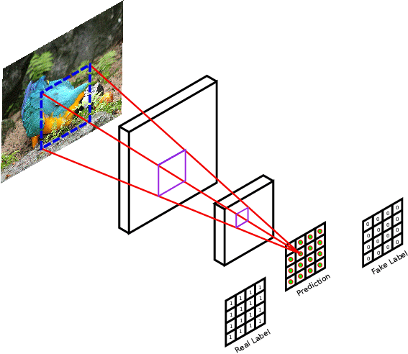
Discriminator

Slide 25
The Pix2Pix model uses discriminator called PatchGAN, which segments the image into matrix of patches of size 70*70
PatchGAN classifier—it tries to classify if each image patch is real.
Run this discriminator convolutionally across the image, averaging all responses to provide the ultimate output.
Each value of the output matrix represents the probability of whether the corresponding image patch is real or artiﬁcially generated.

Slide 26
The discriminator receives 2 inputs:
The input image and the target image, which it should classify as real.
The input image and the generated image (the output of the generator), which it should classify as fake.
Each block in the discriminator is: Convolution -> Batch normalization -> Leaky ReLU.
The shape of the output after the last layer is (batch_size, 30, 30, 1).
Each 30 x 30 image patch of the output classifies a 70 x 70 portion of the input image.

Slide 27
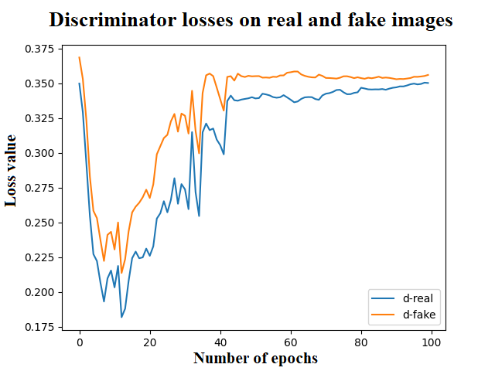
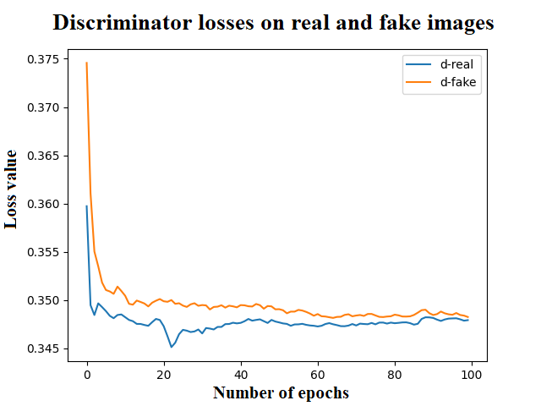
Discriminator loss
The loss is a binary cross-entropy loss of the images and an array of ones.
Fig: Discriminator Loss for first 5K images
Fig: Discriminator Loss for second 5K images

Slide 28
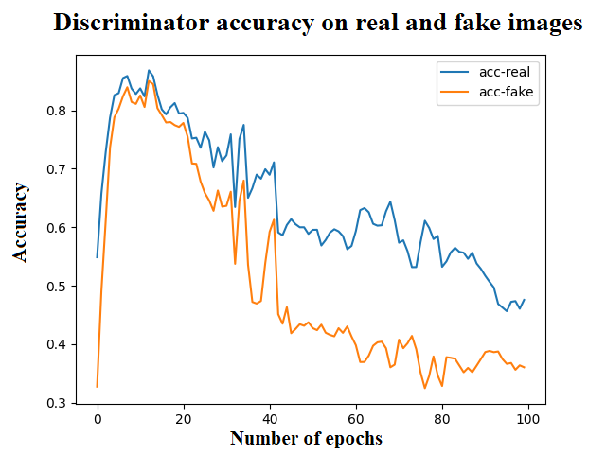
Fig: Discriminator Accuracy for first 5K images
Fig: Discriminator Accuracy for second 5K images

Slide 29
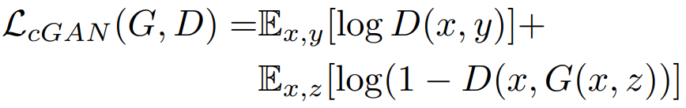

Minimax loss:
Mean Absolute Error (L1 loss) :
Final objective function:

Slide 30
Frontend development:
JavaScript – React
CSS
Backend development:
Node JS
Python

Slide 31
Tasks completed
A homepage showcasing the basic functionality of our application has been created.
Reviewed some research papers on GAN models used for image inpainting.
Obtained “places” dataset and prepared the data in a suitable form to train the model.

Slide 32
Tasks remaining
Dynamic properties of the web application need to be added.
GAN model with the corresponding generator and discriminator needs to be built.
Customizing the model to increase accuracy.
Building database, creating APIs.

Slide 33
References
[1] S. Salve, T. Shah, V. Ranjane, and S. Sadhukhan, "Automatization of coloring grayscale images using convolutional neural network," 2018.
[2] V. K. Putri and M. I. Fanany, "Sketch plus colorization deep convolutional neural networks for photos generation from sketches," pp. 1-6, 2017.
[3] H. H. Chen Y, "An improved method for semantic image inpainting with gans: progressive inpainting.," Neural Process Lett, p. 1355–1367, 2019.
[4] Vitoria P, Sintes J, Ballester C, "Semantic image inpainting through improved Wasserstein generative adversarial networks," 2018.
[5] Nazeri K, Ng E, Joseph T, Qureshi F, Ebrahimi M, "Edgeconnect: generative image inpainting with adversarial edge learning," 2019.
[6] Yuan L, Ruan C, Hu H, Chen D, "Image inpainting based on patch-GANs," 2019.

Slide 34
Thank You

